Slide 1

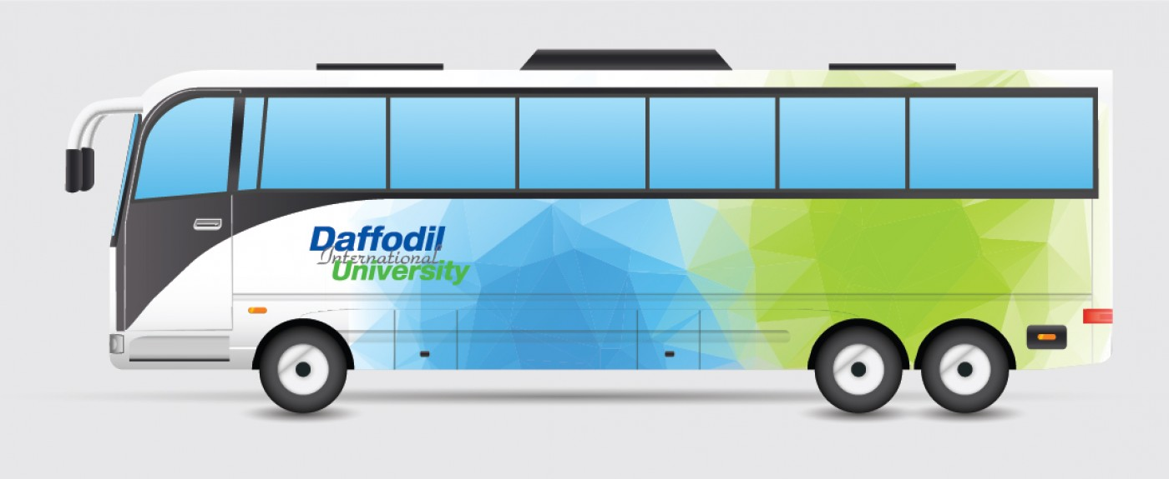
DIU Transport Service Mobile Application
Team Members
Mst. Habiba Sultana(221-15-5528)
Shahriar Hossain Tamim(221-15-5385)
Samia Saimun Etu(221-15-5230)
Make Transport service easier

Slide 2

Project Overview
The app offers on-demand ride booking, real-time tracking, and a variety of transportation options, catering specifically to the needs of the DIU students. Also, Transport service apps can help students by making getting to and from university(or other destinations) safer, easier, and more trackable.

Slide 3

Project Vission & Mission
The Daffodil International University (DIU) Transport Service project aims to provide suitable transportation for students, faculty, and staff.
New Buses:
Fixed Routes
Real-Time Tracking
Easy Payment
Safety First
Eco-Friendly

Slide 4

What we aim for
To develop a user-friendly software for the user
1.Optimized 4.Enhanced Convenience
2.Network & Data optimized 5.Real-time Tracking and
Optimization
3.Flexibility 6.Monitor Performance
and Maintain Visibility
7.Seamless Movement and Efficiency

Slide 5






Development tools and software

Slide 6
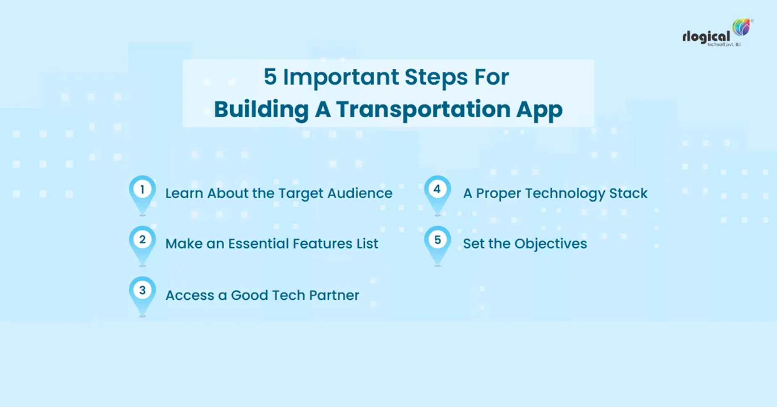
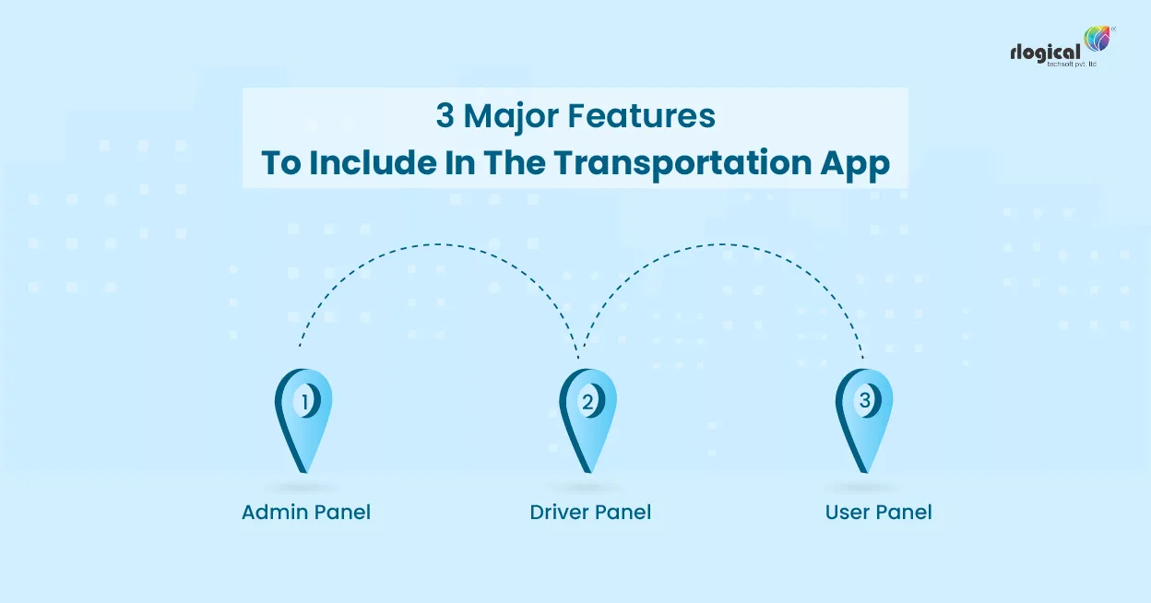
Core Features

Slide 7
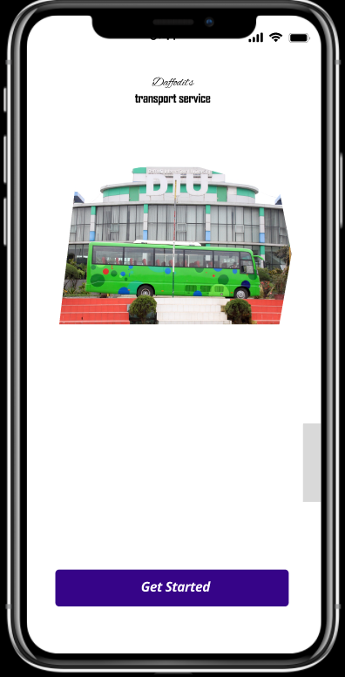
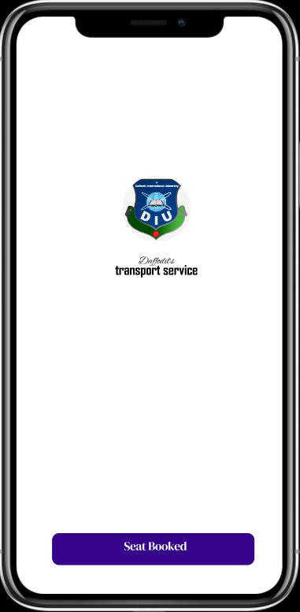
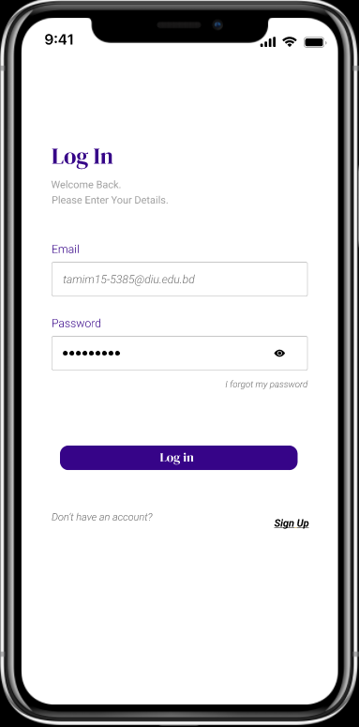
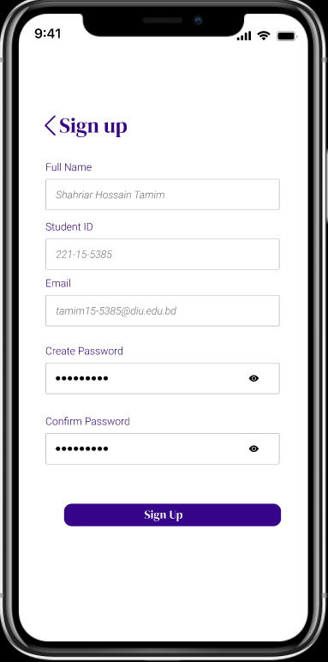
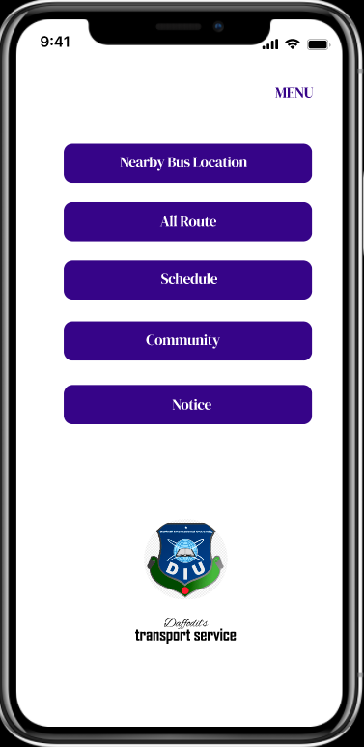
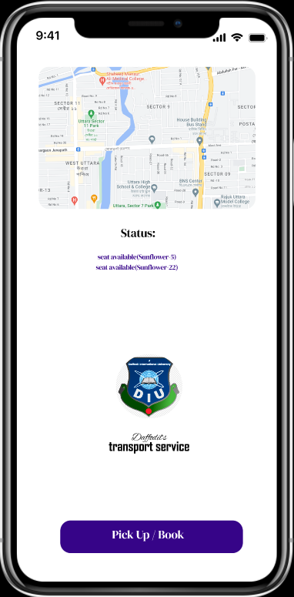
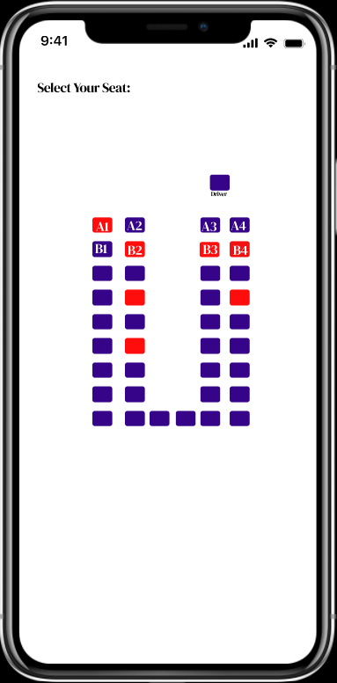
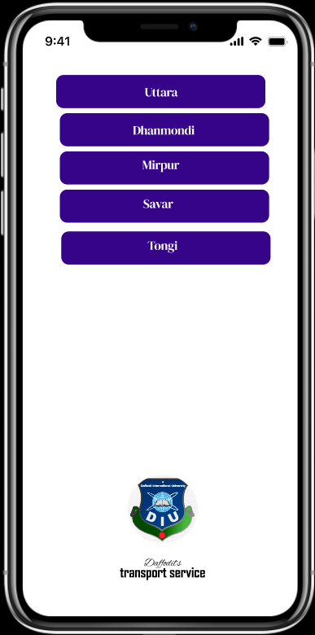
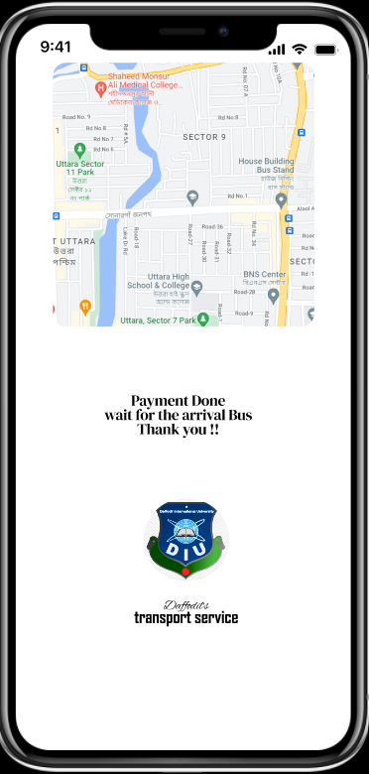
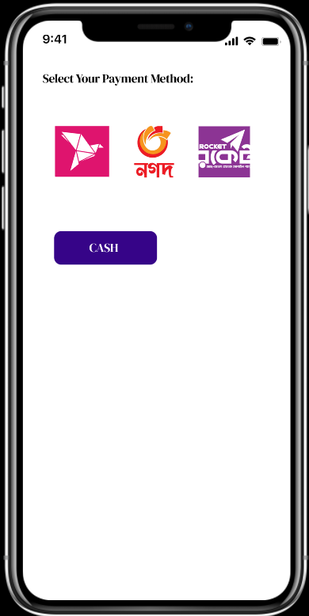
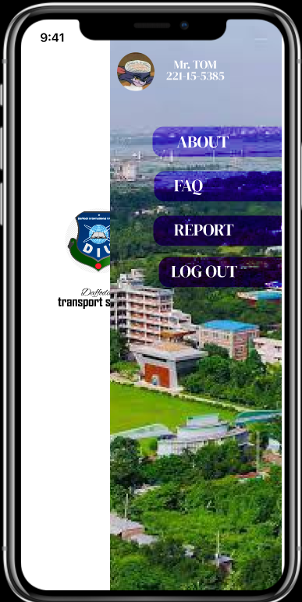
Features

Slide 8

Future Work
1.Driver Contact
2.Helpline
3.Payment throught Transport Card
4..Apply for Transport Card

Slide 9
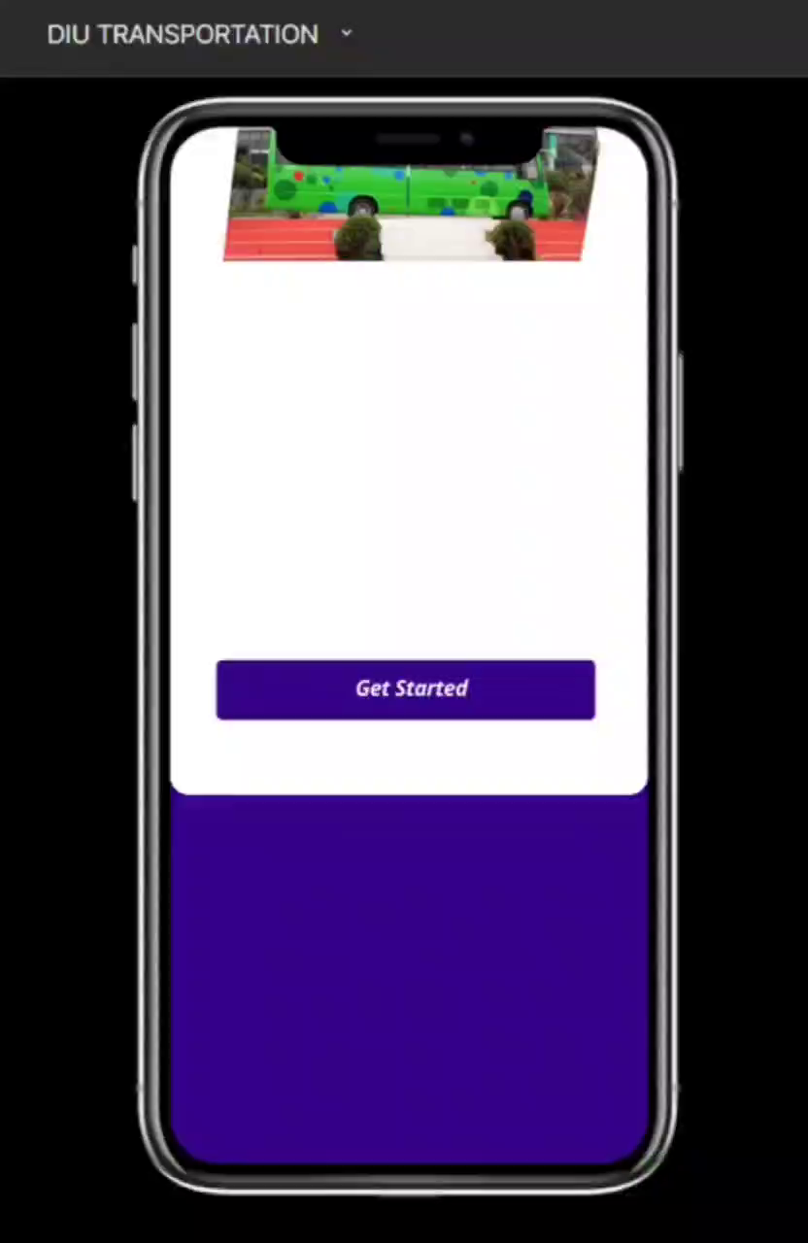
visualization

Slide 10


